Slide 1




Website Design
Welcome to the World Of Web Development
ERGS Website Design
Mr Butler | My Account | Logout

Slide 2
Starter: What is this?
<HEADER> <TITLE>The World Wide Web project</TITLE> <NEXTID N="55"> </HEADER> <BODY> <H1>World Wide Web</H1>The WorldWideWeb (W3) is a wide-area<A NAME=0 HREF="WhatIs.html"> hypermedia</A> information retrieval initiative aiming to give universal access to a large universe of documents.<P> Everything there is online about W3 is linked directly or indirectly to this document, including an <A NAME=24 HREF="Summary.html">executive summary</A> of the project, <A NAME=29 HREF="Administration/Mailing/Overview.html">Mailing lists</A> , <A NAME=30 HREF="Policy.html">Policy</A> , November's <A NAME=34 HREF="News/9211.html">W3 news</A> , <A NAME=41 HREF="FAQ/List.html">Frequently Asked Question </A> . <DL> <DT><A NAME=44 HREF="../DataSources/Top.html">What's out there?</A> <DD> Pointers to the world's online information,<A NAME=45 HREF="../DataSources/bySubject/Overview.html"> subjects</A> , <A NAME=z54 REF="../DataSources/WWW/Servers.html">W3 servers</A>, etc. <DT><A NAME=46 HREF="Help.html">Help</A> <DD> on the browser you are using <DT><A NAME=13 HREF="Status.html">Software Products</A> <DD> A list of W3 project components and their current state. (e.g. <A NAME=27 HREF="LineMode/Browser.html">Line Mode</A> ,X11 <A NAME=35 HREF="Status.html#35">Viola</A> , <A NAME=26 REF="NeXT/WorldWideWeb.html">NeXTStep</A>, <A NAME=25 HREF="Daemon/Overview.html">Servers</A> , <A NAME=51 HREF="Tools/Overview.html">Tools</A> ,<A NAME=53 HREF="MailRobot/Overview.html"> Mail robot</A> ,<A NAME=52 HREF="Status.html#57"> Library</A> )<DT><A NAME=47 HREF="Technical.html">Technical</A> <DD> Details of protocols, formats, program internals etc <DT><A NAME=40 HREF="Bibliography.html">Bibliography</A> <DD> Paper documentation on W3 and references. <DT><A NAME=14 HREF="People.html">People</A> <DD> A list of some people involved in the project. <DT><A NAME=15 REF="History.html">History</A> <DD> A summary of the history of the project. <DT><A NAME=37 HREF="Helping.html">How can I help</A> ? <DD> If you would like to support the web.. <DT><A NAME=48 HREF="../README.html">Getting code</A> <DD> Getting the code by<A NAME=49 HREF="LineMode/Defaults/Distribution.html"> anonymous FTP</A> , etc.</A> </DL> </BODY>

Slide 3
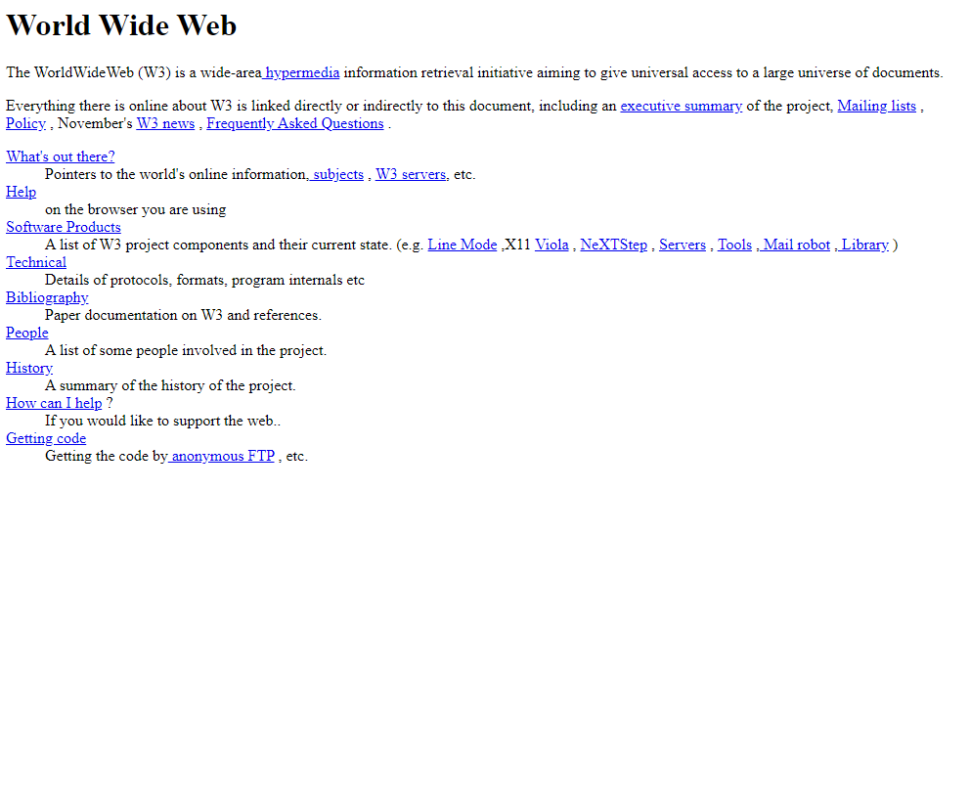
The First Website
It was made in August 6, 1991 by Tim Berners-Lee – a very important Computer Scientist of his time.
It might look like much, but actually this technology isn’t just a Microsoft Word Document. This information was able to be opened and read from all over the US – and now all over the world.

Slide 4
The First Website
<HEADER> <TITLE>The World Wide Web project</TITLE> <NEXTID N="55"> </HEADER> <BODY> <H1>World Wide Web</H1>The WorldWideWeb (W3) is a wide-area<A NAME=0 HREF="WhatIs.html"> hypermedia</A> information retrieval initiative aiming to give universal access to a large universe of documents.<P> Everything there is online about W3 is linked directly or indirectly to this document, including an <A NAME=24 HREF="Summary.html">executive summary</A> of the project, <A NAME=29 HREF="Administration/Mailing/Overview.html">Mailing lists</A> , <A NAME=30 HREF="Policy.html">Policy</A> , November's <A NAME=34 HREF="News/9211.html">W3 news</A> , <A NAME=41 HREF="FAQ/List.html">Frequently Asked Question </A> . <DL> <DT><A NAME=44 HREF="../DataSources/Top.html">What's out there?</A> <DD> Pointers to the world's online information,<A NAME=45 HREF="../DataSources/bySubject/Overview.html"> subjects</A> , <A NAME=z54 REF="../DataSources/WWW/Servers.html">W3 servers</A>, etc. <DT><A NAME=46 HREF="Help.html">Help</A> <DD> on the browser you are using <DT><A NAME=13 HREF="Status.html">Software Products</A> <DD> A list of W3 project components and their current state. (e.g. <A NAME=27 HREF="LineMode/Browser.html">Line Mode</A> ,X11 <A NAME=35 HREF="Status.html#35">Viola</A> , <A NAME=26 REF="NeXT/WorldWideWeb.html">NeXTStep</A>, <A NAME=25 HREF="Daemon/Overview.html">Servers</A> , <A NAME=51 HREF="Tools/Overview.html">Tools</A> ,<A NAME=53 HREF="MailRobot/Overview.html"> Mail robot</A> ,<A NAME=52 HREF="Status.html#57"> Library</A> )<DT><A NAME=47 HREF="Technical.html">Technical</A> <DD> Details of protocols, formats, program internals etc <DT><A NAME=40 HREF="Bibliography.html">Bibliography</A> <DD> Paper documentation on W3 and references. <DT><A NAME=14 HREF="People.html">People</A> <DD> A list of some people involved in the project. <DT><A NAME=15 REF="History.html">History</A> <DD> A summary of the history of the project. <DT><A NAME=37 HREF="Helping.html">How can I help</A> ? <DD> If you would like to support the web.. <DT><A NAME=48 HREF="../README.html">Getting code</A> <DD> Getting the code by<A NAME=49 HREF="LineMode/Defaults/Distribution.html"> anonymous FTP</A> , etc.</A> </DL> </BODY>

Slide 5
Some of the things wrong with websites are usually:
Colour schemes/too many colours
Layout is hard to navigate
Text is difficult to read
Eyes drawn all over the place – no order to where you should look!
Pictures aren’t clear
No alignment to text/textboxes
More can be found on the next slide…

Slide 6
Some of the things wrong with these are:
Header graphic is pixelated and over-optimized. Transparency in header graphic is overdone. Multiple font colors used in "ever“
Animated stars (all animated gifs are generally a bad idea) Under construction graphics should never be used The notice "Under Construction" should almost never be used, especially on the homepage
"<--" and other text-based markers/graphics are a faux pas in design This page, filenamed "new_page_1.htm" indicates poor file naming and organization "Main Menu" shouldn't exist; if people don't know what a main menu is, they shouldn't be on the web
Teenie-bopper spellings such as "kewl" should never be used on any professional website I personally despise *smile* - please try to avoid it for my own sanity's sake Email icons are also really annoying, especially in they are animated
Repeating backgrounds are almost always a bad idea Backgrounds that have color almost never work Beveled images, such as in the background image, are almost always unprofessional-looking
In the yellow table near the top, the cell width is different from the table width, creating blank space on the right side Mouseovers for links can be done professionally and add a nice touch to a website, but text should never be resized or bolded when the cursor moves over it
Inconsistency in the main menu is running rampant. If you're going to have icons, have them all the links The border around the icons is way too thick. I see this a lot
The main menu option "GOOGLE MAPS" is not fully hyperlinked The link "WEATHER" doesn't work Flashing "New" or "Updated" icons are generally considered cheese-ball. Avoid them!
Multiple fonts are used throughout the website, including some that are not web-safe There are numerous misspelled words in the "What's New" section Again, "1" for "one" and "u" for "you" are terrible for professional websites.
Scrolling marquees can be effective if used non-obtrusively and rarely. "About TWWWE" has no hyperlink There are several examples of Microsoft Word Art on this site. It is almost always a bad idea to use it
Blue on red is a bad idea Red on blue is a bad idea Blue or red on black is a bad idea
I absolutely, unequivocally, hate the font "brush script", which is used in "Fantastic Colours" as well as "The" and "Ever" in the header. It is the most overused script font ever There is a page counter at the bottom. 99% of the time it is a bad idea to have a public counter on your page
The link "Shocking Pictures" goes to the "Shocking Photos" section. Most of the time the link and the page/section title should be the same There are varying table widths on this site. Consistency is key!
There is a table that is too long for the screen, creating a horizontal scrollbar. Horizontal scrollbars are bad, bad, bad!
In addition to numerous misspelled words, there is several examples of bad grammar, including "These photos are SHOCKINGLY formatted HORRIFICLY"
The first photo on the left is formatted wrong. It is actually a large photo resized using HTML. This is bad because photo quality is lost, but most importantly the size of the file is huge, which takes a long time to download.
The second photo from the left is also formatted wrong. It is beveled (which is really personal taste, not necessarily wrong) and over-optimized. Notice the bleeding colors
The third image might be hard to tell at first. If you look closely, the sunset colors are grainy. This is because the image was saved as a gif instead of a jpg. When working with images of brilliant colors, save them as jpgs and not gifs. This is because gifs are limited to 256 colors while jpgs are virtually limitless
The fourth image is what happens when you take a small photo and increase it's size. Despite what CSI: Miami does, you cannot blow up images and make them look good
A funny bit, at least humorous to me, is the word "Trifecta" used on the fourth photo When laying out photos left to right, if possible, make sure they are the same size
The text box that says "Could we possibly do any more, said the cat" is a triple-whammy. First, it doesn't make sense. Secondly, it has nothing to do with the site's content. And thirdly, it is a graphic when it should be plain HTML text.
Last updated scripts are mostly a bad idea. The only exceptions is if you update your site very often (almost daily) and probably should be used for blogs, news sites or the like "Sight" being used instead of "site". I actually see this occur too often
MIDIs (the music playing in the background) are officially my biggest pet-peeve. They should never be used under any circumstance. Almost all embedded sounds, not just midis, are very annoying
The embedded midi cannot be turned off and loops forever. If you must have sound on your website, give people the QUICK option to turn it off Another pet-peeve is text and images that butt-up against the table's border. To fix this, add cell or table padding

Slide 7
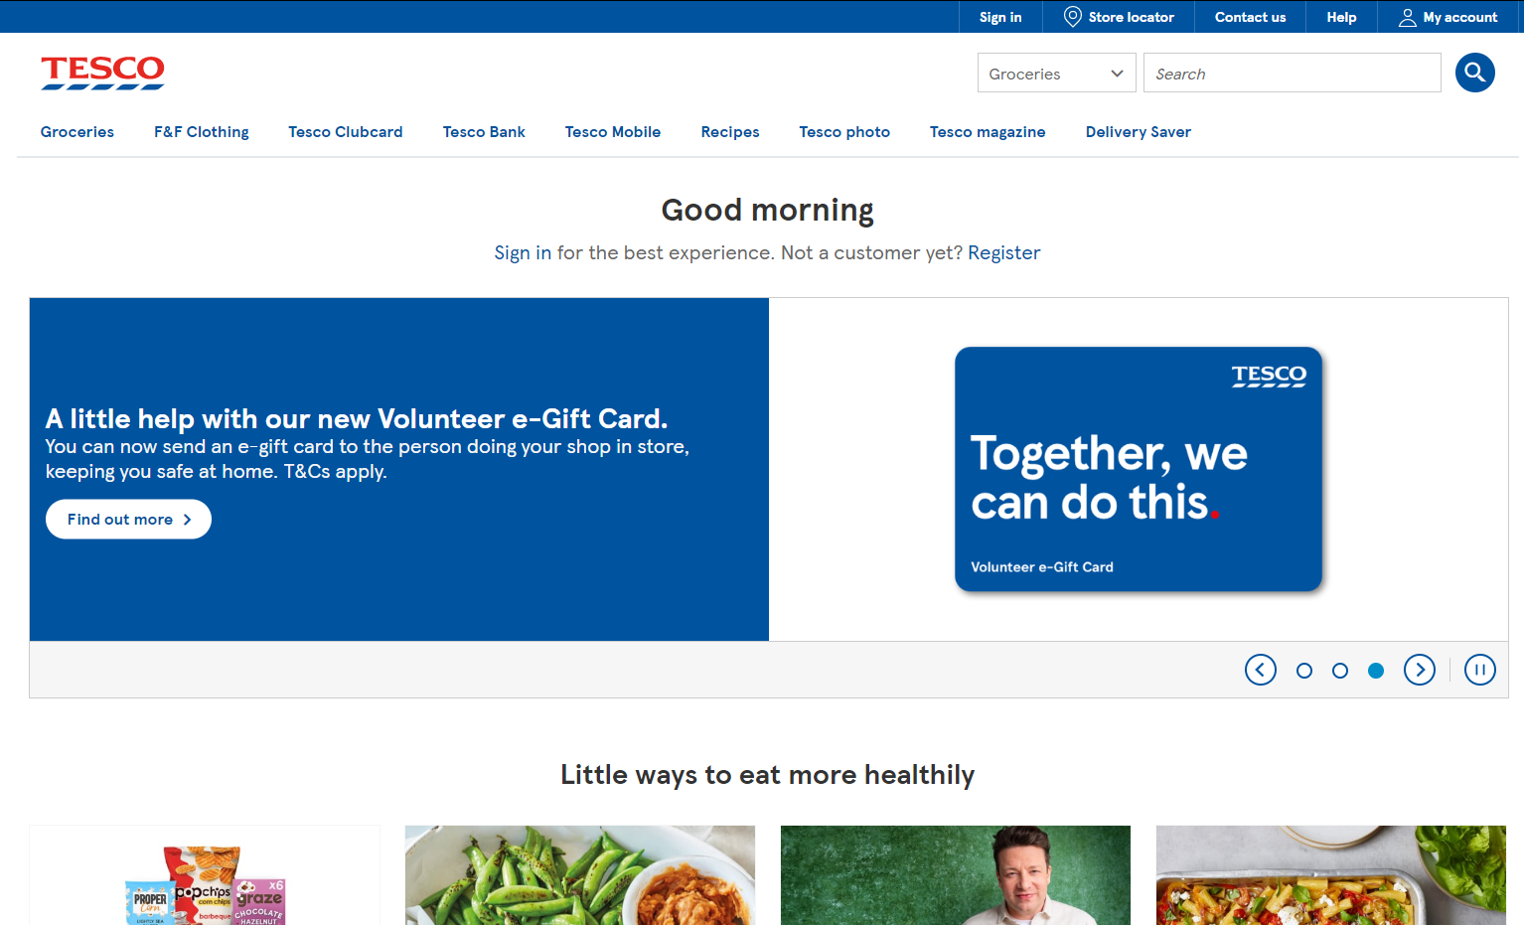
That’s a LOT of issues…
So how do we resolve these? Well actually, a lot of these can be rectified quite quickly;
  Keep your website clean and clear (balance)
  Ensure your navigation is easy to work
  Keep your page layout consistent
  Make sure your images are clear, appropriate and of a suitable size
  Ensure text is readable and consistent
  Ensure your colour scheme is well thought out – usually 3-5 colours.

Slide 8
Navigation
Navigation is a key design aspect when you are designing a website
It must be easy to use for your target audience.
Research shows that users will not use a website if it is difficult to navigate around
Consistency in menus and buttons is super important
  The Menu should be the same on every page of the website
  Main menu should be clearly identifiable
  Each button should be clearly named (The user should know exactly what to expect if button x is pressed).
  Rollover effects on buttons are good design features – so long as they don’t distract the user!

Slide 9
Key Terms Used in Websites
Key Term | Definition
World Wide Web | A huge collection of websites that we can access through the internet. Holds webpages and web resources (such as images and videos) and can be accessed over the internet. It is the software hosted on the internet.
Internet | A global network consisting of interconnected computers. It is the hardware that communicates with one another.
Web Pages | Each website has multiple screens known as web pages.
Hyperlinks | We can navigate and click between webpages using hyperlinks. You click on a word or image to take you to another web page
Internet Browser | This is a program that reads and displays HTML documents. It does not display the HTML tags, but uses them to display the document.

Slide 10

HTML
Stands for ‘Hyper Text Mark-up Language
It is the computer language used on the WWW.
It described the content and structure of a web page.
Nearly every website is designed and made using this language, with the latest version being HTML 5.
It is structured using tags, each of which are used for its own purposes.

Slide 11
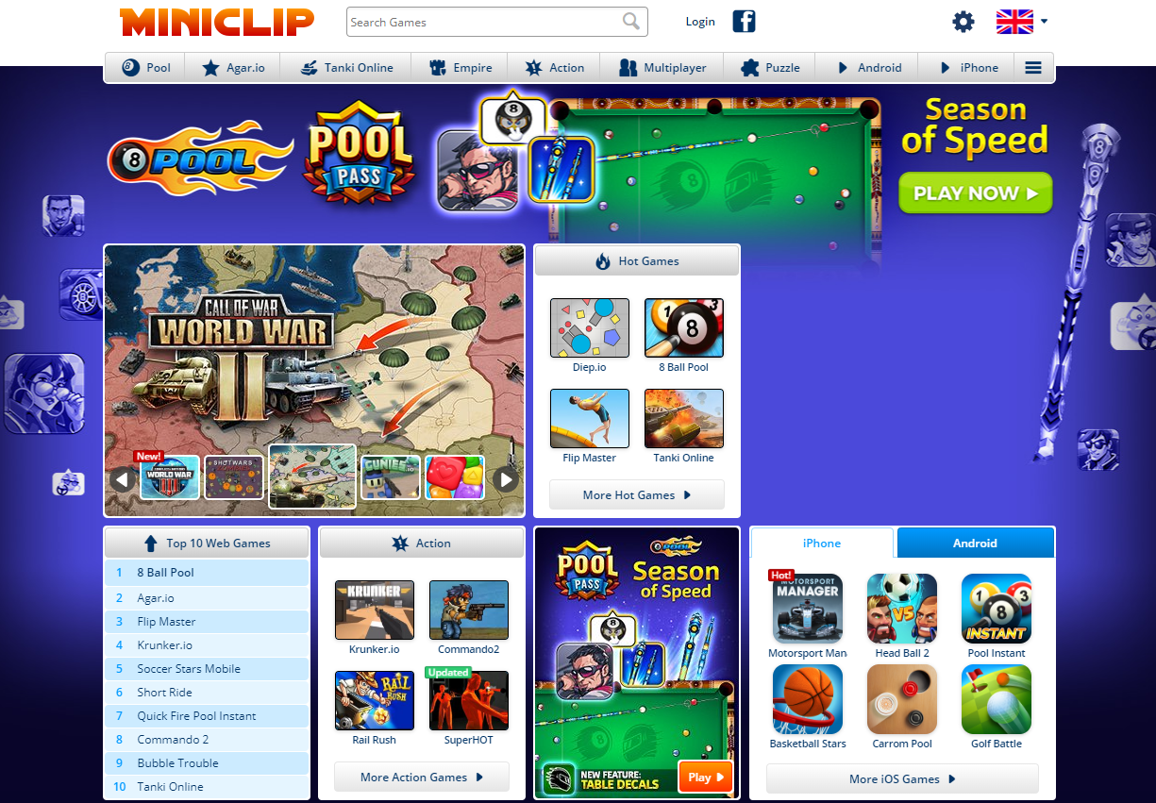
The websites you see aren’t what they seem
Developers don’t use Microsoft word documents or Wix to create websites.
What you are actually seeing when you open a webpage might be something like this:

Slide 12
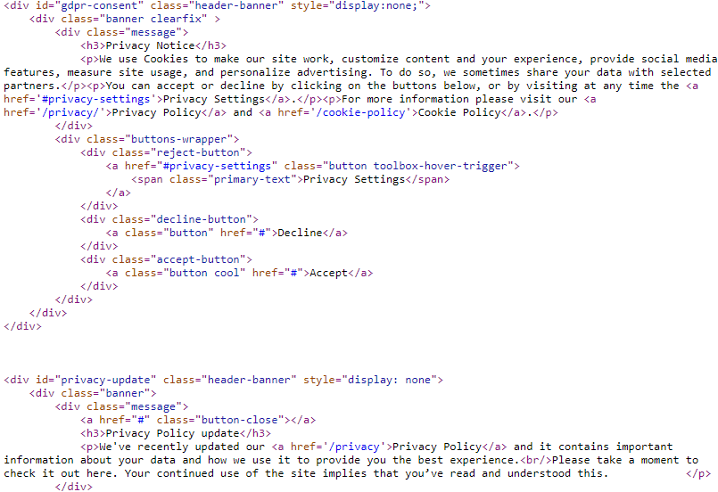
The websites you see aren’t what they seem
But actually it’s only a simple text document. Your internet browser ‘reads’ this text file and interprets this text to make it appear differently!
It’s a bit like reading a book. Your imagination creates images and yet it is just words on a page
In case of websites, your browser creates the image.

Slide 13

It’s not as complicated as it sounds or looks!
‘Tags’ are used throughout a html document
These tags use angled brackets < and >
Tags nearly almost always come in pairs. If you open a tag, then you must also close it. The closing tag also is denoted by a forward slash /
Tags can have attributes to alter their appearance and functions.
Tags can be embedded inside each other. For example:
Closing the title Tag
Opening the Head tag
Closing the head Tag
The title tag is inside the head tag

Slide 14
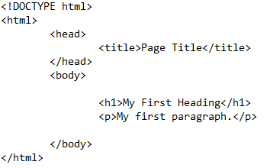
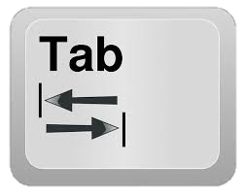
HTML
HTML tags label piece of content such as ‘heading’, ‘paragraph’ and ‘table’
Browsers to not display these tags directly, but use these to render content on screen
Here is a very simple HTML file. Note we use the tab key ( ) to align embedded content. If a tag is ‘inside’ another, it should be tabbed in.

Slide 15
HTML File Explained
The <!DOCTYPE html> declaration defines the document to be a html5.
The <html> element is the root element – EVERY TAG needs to be inside these!
<head> contains meta information about the document.
<title> specifies a title for the document (what appears in the tab in the browser)

Slide 16
HTML File Explained
The <body> element contains the visible content of the page
<h1> is ‘heading 1’ tag, which is used for a large heading on screen. There are other headings available also, such as <h2>.
The <p> element defines a ‘paragraph’

Slide 17
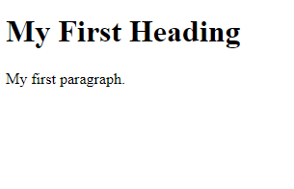
The Output of this file in the browser

Slide 18
So, basically:
The starting tag (AKA opening tag) goes here and is surrounded in angled brackets, < and >
To end a tag, you write it just like the starting tag, but with a forward slash, /, inserted before the tag name.
<tagname>Content to be displayed can go here…</tagname>
Anything you want to actually display on screen goes here, between the opening and closing tags

Slide 19
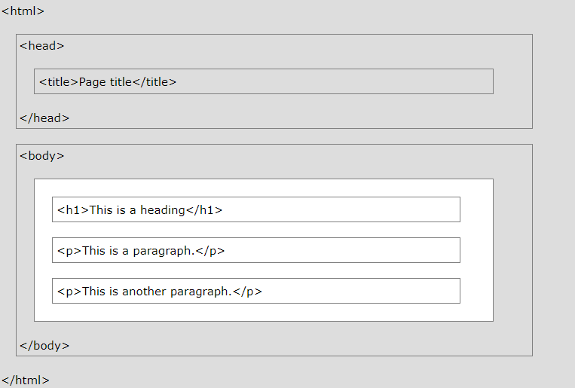
HTML Page Structure
Only the part in White section is actually displayed by the browser.
It is very important, however, that the tags in the grey area are still present as they are used by the browser.

Slide 20
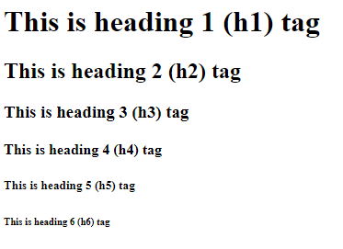
HTML Headings
So, usually at the top of a page we would have a nice big title – something prominent. It’s the same for websites
We can use headings for this, and we can use the <h1> to <h6> tags.
h1 is the first heading, so is usually the biggest.
h2, is next biggest, and so on…

Slide 21

HTML Paragraphs
Paragraphs are often used in web pages, just like in standard texts.
Defined with the <p> tag.
Task: Open your website up in Notepad (Go To File > Open when you are in Notepad). Add a Third paragraph to the website, telling me about:
  Your name and family
  Your favourite sports team (if you had to pick)
Edit the First paragraph to display “This is a tagline” in the browser.

Slide 22
Linking HTML Pages
HTML links, or hyperlinks, are defined using the anchor <a> tag.
They use an attribute within the element. This goes inside the opening tag.
An example is shown below:
There is still the end tag.
This is still an opening tag. As said, this is an <a> tag.
The href attribute is used to say the destination i.e. where we will go when we press the link. It is not displayed in the browser. It is just the instruction of ‘where to go’
The text displayed on screen is still placed between the start tag and the end tag, and will actually be displayed in the browser.
<a href=“https://www.google.com”>Click Here to go to Google</a>

Slide 23
HTML Images
It’s very important to have images in websites – they are both informative and engaging, ensuring visitors are attracted to the website.
The tag used is <img>
This is one that doesn’t have a closing tag – it is known as a self-closing tag as no text is actually placed on screen here. Instead it has a few attributes to tell the browser what to display:
The ‘src’ is the source. It’s the where the image is saved. Here I have a jpeg image in the C:/ drive called ‘myimage’
The width and height attributes can also be used here to set the size of the image on screen.
The tag is img.
The ‘Alt’ attribute is text displayed in the browser if the image cannot be found or is corrupt. It’s also used for screen readers.
This is how we show it is self-closing.
<img src=“C:/myimage.jpg” alt=“My Logo” width=“64” height=“32” />

Slide 24
HTML Lists
There are two kinds of lists we can use in html.
  Numbered, or ordered lists <ol>
  Bullet points, or unordered lists <ul>
Inside these tags, you can then embed the list items <li>
<ol>
<li>Apples</li>
<li>Oranges</li>
<li>Bananas</li>
</ol>
Apples
Oranges
Bananas
<ul>
<li>Apples</li>
<li>Oranges</li>
<li>Bananas</li>
</ul>
Apples
Oranges
Bananas

Slide 25
There are loads more, but that shows you the basics.
Points to remember:
  An HTML element is defined by a start tag, some content, and an end tag.
  A start tag may also contain attributes that act as instructions for the browser
  Some tags, like the image <img> tag, do not have a closing tag and are called self-closing.
  Tags can be embedded inside each other
  All content being displayed on the webpage must be embedded inside the body tag.
  Some attributes must be included when using certain tags (such as a href attribute within a hyperlink, <a> tag.

Slide 26

Hyperlinking Webpages
In that quiz, you saw how to a hyperlink:
<a href=“home.html”></a>
You’ll notice there isn’t a ‘file path’ like C:/HTML/home.html
This is because it is located at the same location as where the link is. This goes back to making sure we have good organisation in terms of files and folders.

Slide 27


Let’s set up our Folders ready for a full HTML website
Inside your Year 9 Folder, Open your ICT folder.
Create a subfolder called HTML if you have not already
Inside this, create a Folder Called MyWebsite
Make two HTML files, one called Index.html and the other called Hobbies.html
(Ensure with the person next to you they have created the html files correctly!
Year 9
ICT
HTML
Graphics
MyWebsite
John Smith
Index.html
Hobbies.html

Slide 28
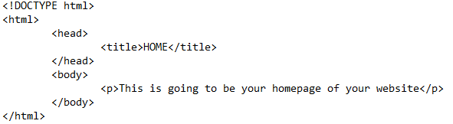
Setting up Index.html
Also used as your homepage and is universally noted as the first page to your website.
Copy in this HTML:
Make sure you save your web page!

Slide 29
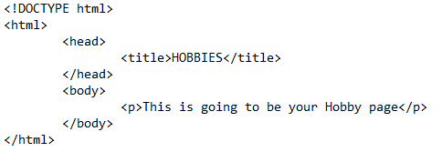
Setting up Hobbies.html
This is going to be a separate page which contains all the information about your hobbies.
Copy in this HTML:
Make sure you save your web page!

Slide 30
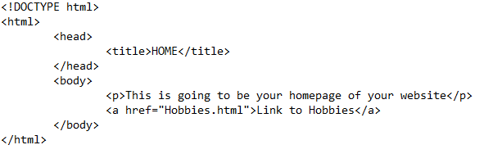
Linking the pages
We are going to link the pages now. Because they are both stored in the same folder (MyWebsite), you don’t need to declare the full file path.
Instead, you can use “Hobbies.html” as your href within an anchor (<a>) tag.

Slide 31
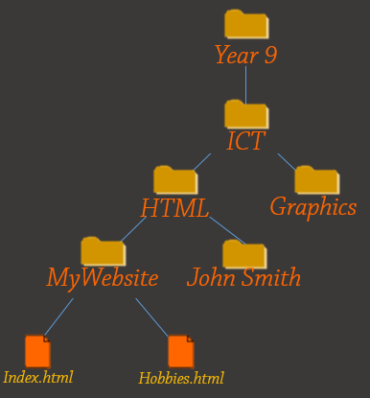
Linking Pages that aren’t in the same Folder
Let’s say we have a folder inside MyWebsite called ‘Contact’, which in turn has a contact.html file
To link to this, you would need to tell the browser where the file is compared to your index:
Contact
contact.html

Slide 32
Create and link all of your pages together now.
You have 5 minutes
Contact
contact.html

Slide 33
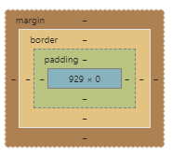
The Div Tag
The division tag is a really versatile element you can use in a html document.
It’s used as a container for HTML elements – meaning is defines a section within a html document.
We are going to use the div tag now to create a navigation bar, or ‘navbar’, along the top of the screen.

Slide 34
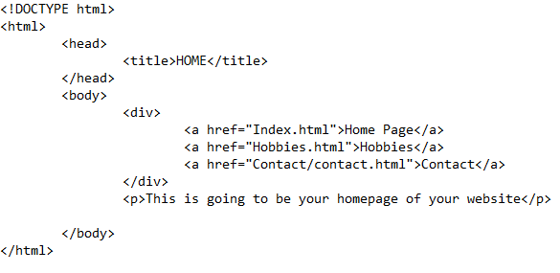
The Div Tag
Modify your Index.html file to look like this. We are going to nest the hyperlinks inside of a div element
Remember to use the Tab Button on your keyboard to indent your tags!

Slide 35
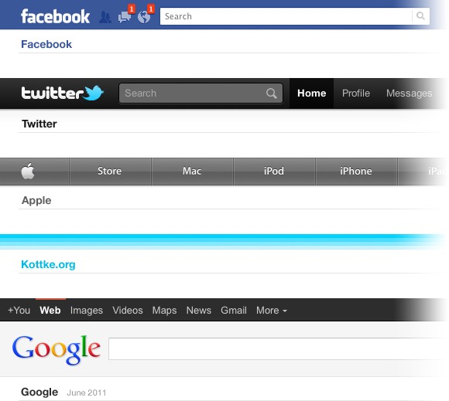
Styling the Div Tag
If we look at navigation bars, you’ll see that whilst there are so many different colour schemes, they all share very similar qualities.
Q. What do you notice about the similarities between them?
Task: Can you think of any other websites that do or don’t follow these rules?

Slide 36
Styling in CSS
As with most things in life, we have so many different approaches to this. We could:
  Use inline styling (not recommended for large projects)
  Use a <style> tag and declare all styling within this tag (recommended if the styling only applies to a single webpage)
  Use an external style sheet (recommended for large projects)

Slide 37
Inline Styling
<h1 style=“color: green; background: yellow”>Heading Text</h1>
You will first notice this is on a single line – which you may think is great. But actually this is one of the worst ways of adding styling, especially when you want lots of cool hover effects or come across some interesting CSS properties!
You’ll see that this would make the heading colour Green on a Yellow background
Should only be used for small CSS which does not repeat anywhere else in the website.

Slide 38
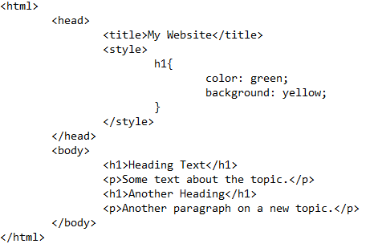
The <style> Tag
Place the <style> tag within the <head> of the website. This will still make the ‘Heading Text’ green on a yellow background.
This style will be used for all <h1> tags on the webpage, not just the single occurrence!
For example, ‘Another Heading’ will also have these colours!
For small websites, or styling that is only used on one page in the entire website, you may want to use the <style> tag.

Slide 39
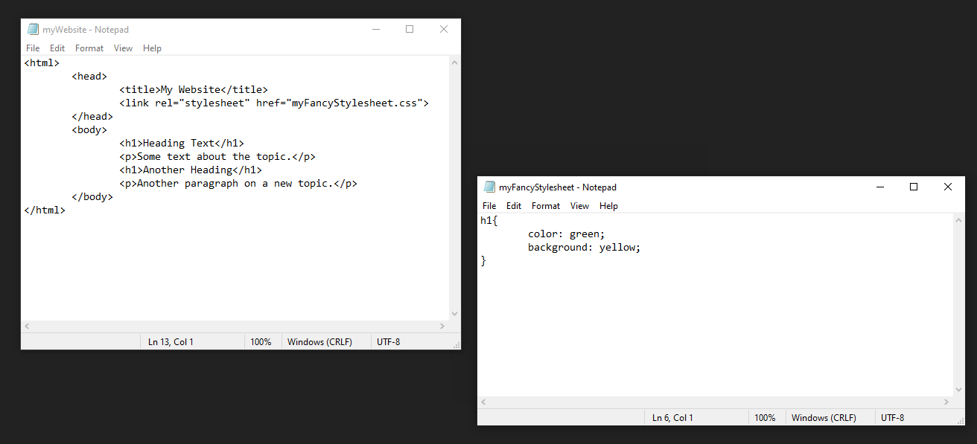
External Style Sheets
Few Important things: You MUST save the CSS in the same location at the HTML webpage
We have introduced a <link> tag into our <head> instead. This tells the browser to look there for the styling
This is how full sized professional websites are made, so we will be using this method!
The CSS is laid out just as it was when we were using the <style> tag, but saved as a .css file (not as a text file)

Slide 40
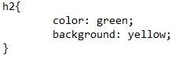
CSS Selectors
CSS Selectors are a way of choosing which tags you want to style.
For example, we used a tag selector to choose/select all the <h1> tags.
If we wanted to select all <h2> tags instead, we could change this.
Or we could have more than one selector like this:
We are going to focus on tag and class selectors now.

Slide 41
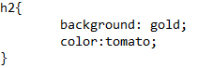
CSS Selectors
Open your John Smith file in Notepad.
Append into the head tag the following:
<link rel="stylesheet" href="myFancyStylesheet.css">
Open your CSS file ‘myFancyStylesheet’ and add in:

Slide 42
What does your website look like now?
Does it look great?

Slide 43
Assessed Assignment: The ERGS Houses
Your assessment for this unit will comprise of a test based around an ERGS houses website.
You will be able to use, open and edit the website during the test, however you will be required to write your answers on the test paper.
You should be able to view the website in Notepadd/Notepad++ however you will not be allowed to use the internet to search for answers.

